Slide 1
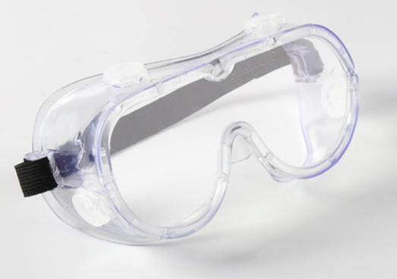
Anti-Fog Protective Goggles
Key Product Specs:
FDA Approved
Anti-fog
Prevent splattering
Shockproof

Slide 2
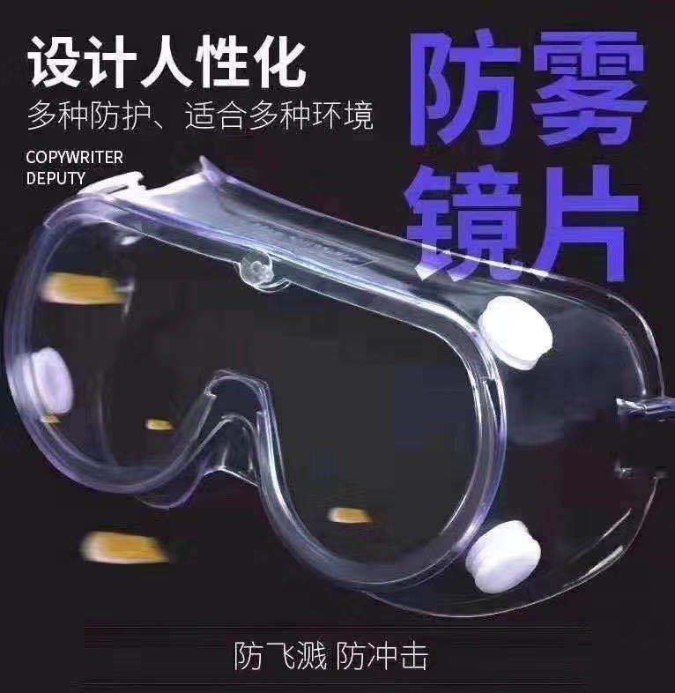
Product Display
Photo

Slide 3
Business & Medical Licenses

Slide 4
Company Info

Slide 5
Test Report

Slide 6
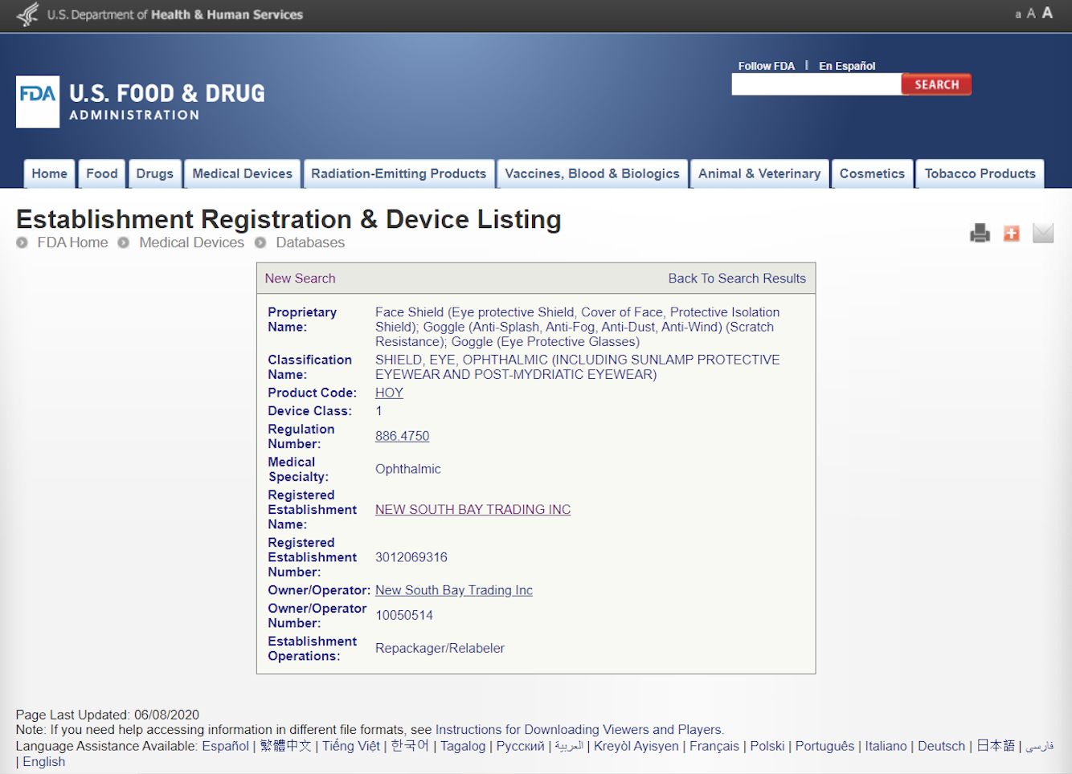
FDA Registration

Slide 7
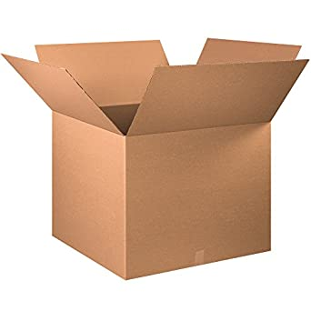
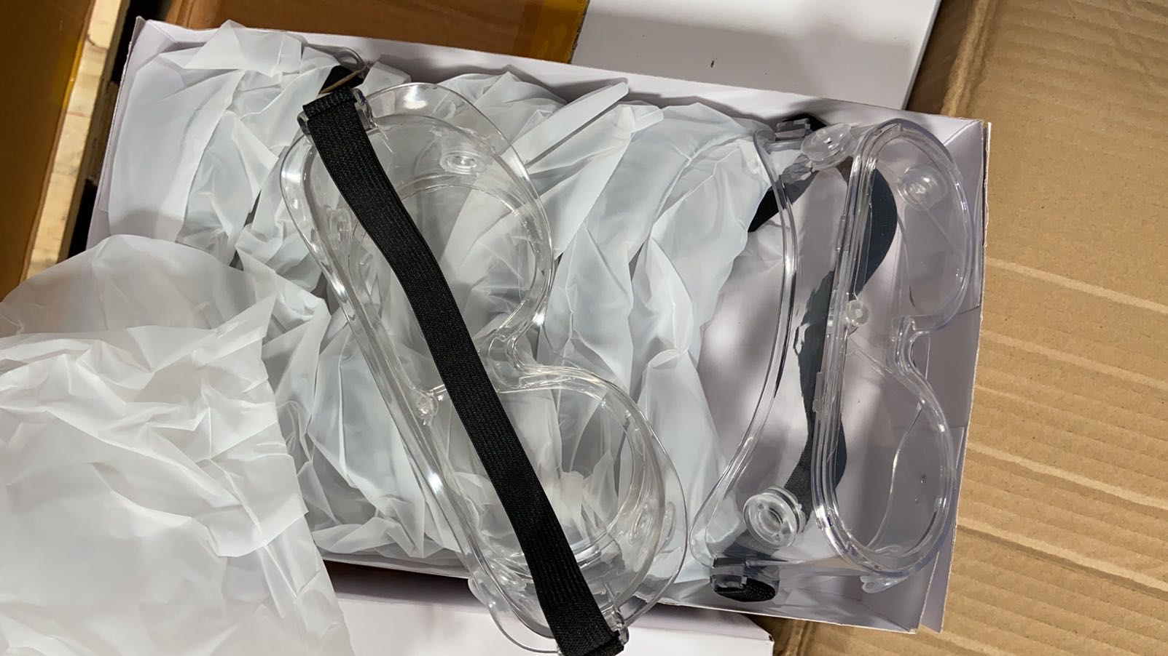
Product Package Info
Inner packaging
Containers/ Carton (Pcs)
Size: 30 x 20 x 10 cm
Material: Plastic
Weight: 900g
Color: Transparent
10 pcs per box
20 boxes per case
200 pcs per case
Carton Dimension: 78 x 35 x 43 cm
G. W.: 18KG

