Slide 1
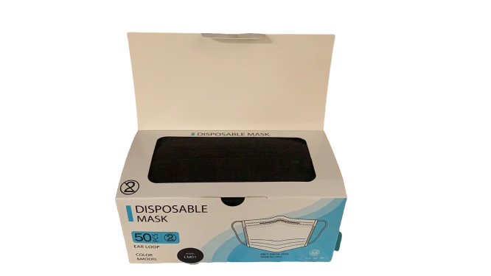
L’ Meri 3-Ply Disposable Masks
Key Product Specs:
FDA Registered
3 layer filtration and triple protection assured
3D cut and breathable
Size: 17.5 x 9.5cm
Black

Slide 2
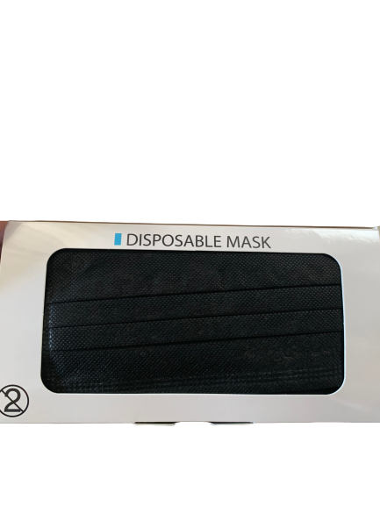
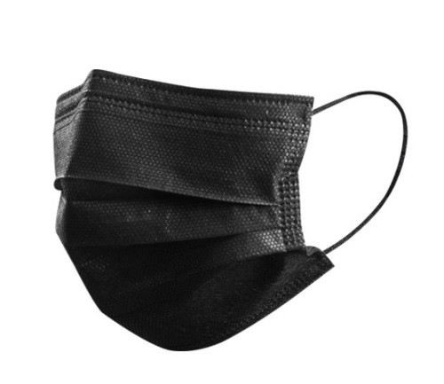
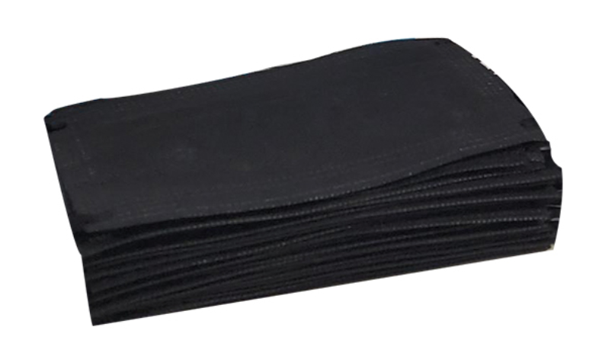
Product Display
Photo

Slide 3
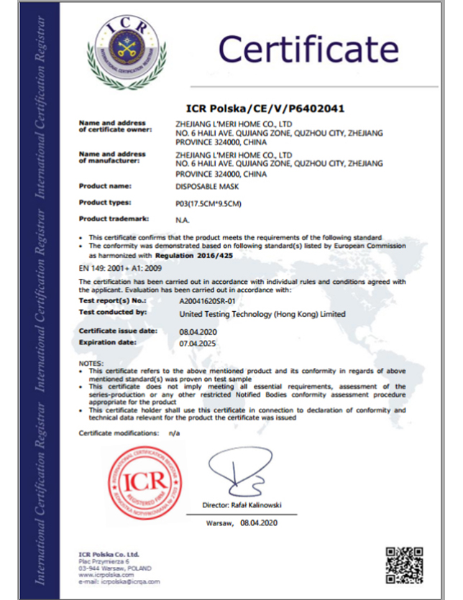
Business & Medical Licenses

Slide 4
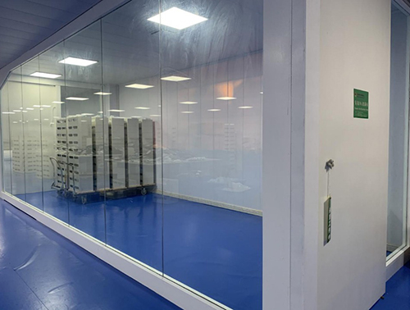
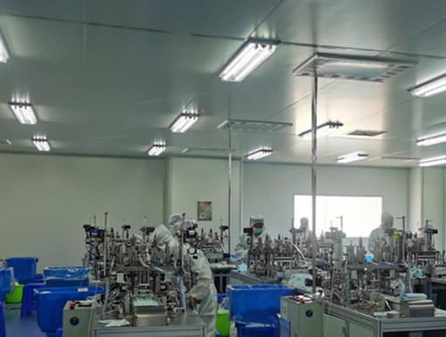
Company Info
Zhejiang Pan Casa co., Ltd. located in Donggang Industrial Zone, Quzhou City Zhejiang Province, a furniture manufacture succeed in becoming an epidemics prevention enterprise, produce daily mask and KN95 mask. Founded on year 2002, employs now more than 500 people and has three production lines produce disposable mask, a daily production capacity of 400,000pcs to 500,000pcs and ten production lines produce KN95 mask, a daily production capacity of 400,000pcs to 500,000pcs.

Slide 5
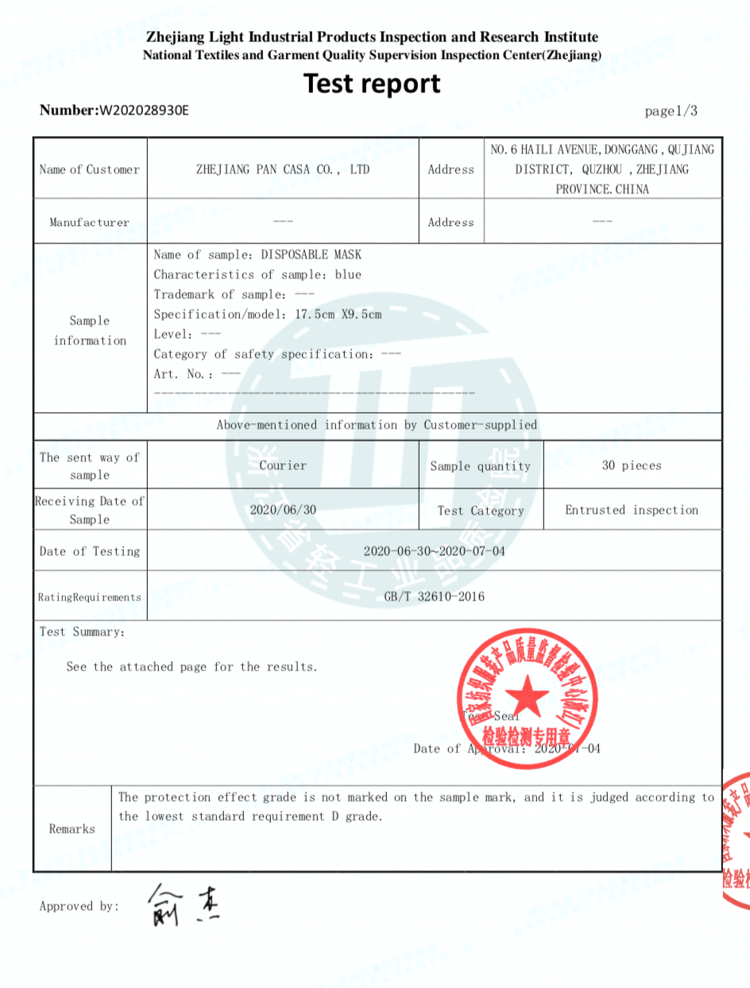
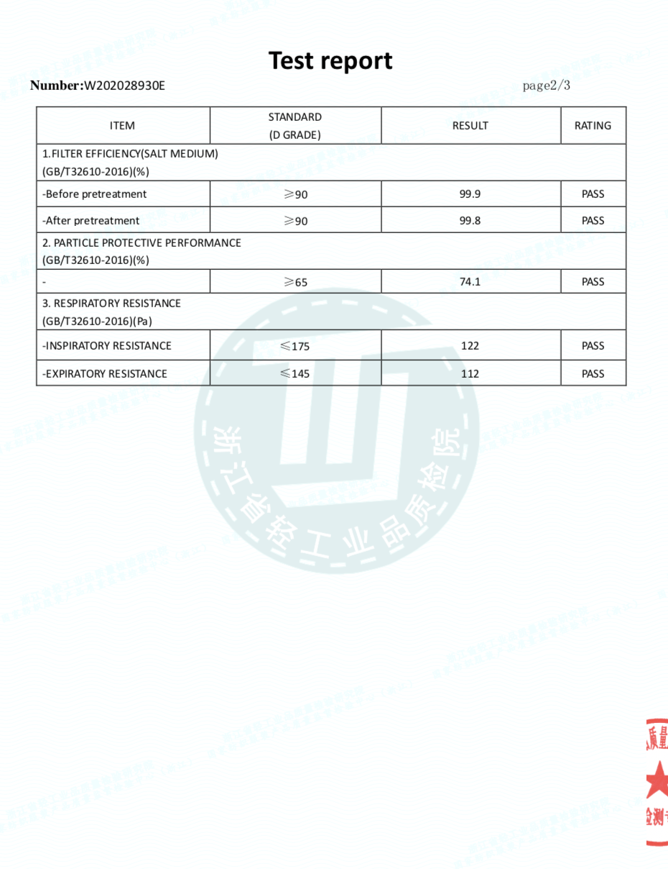
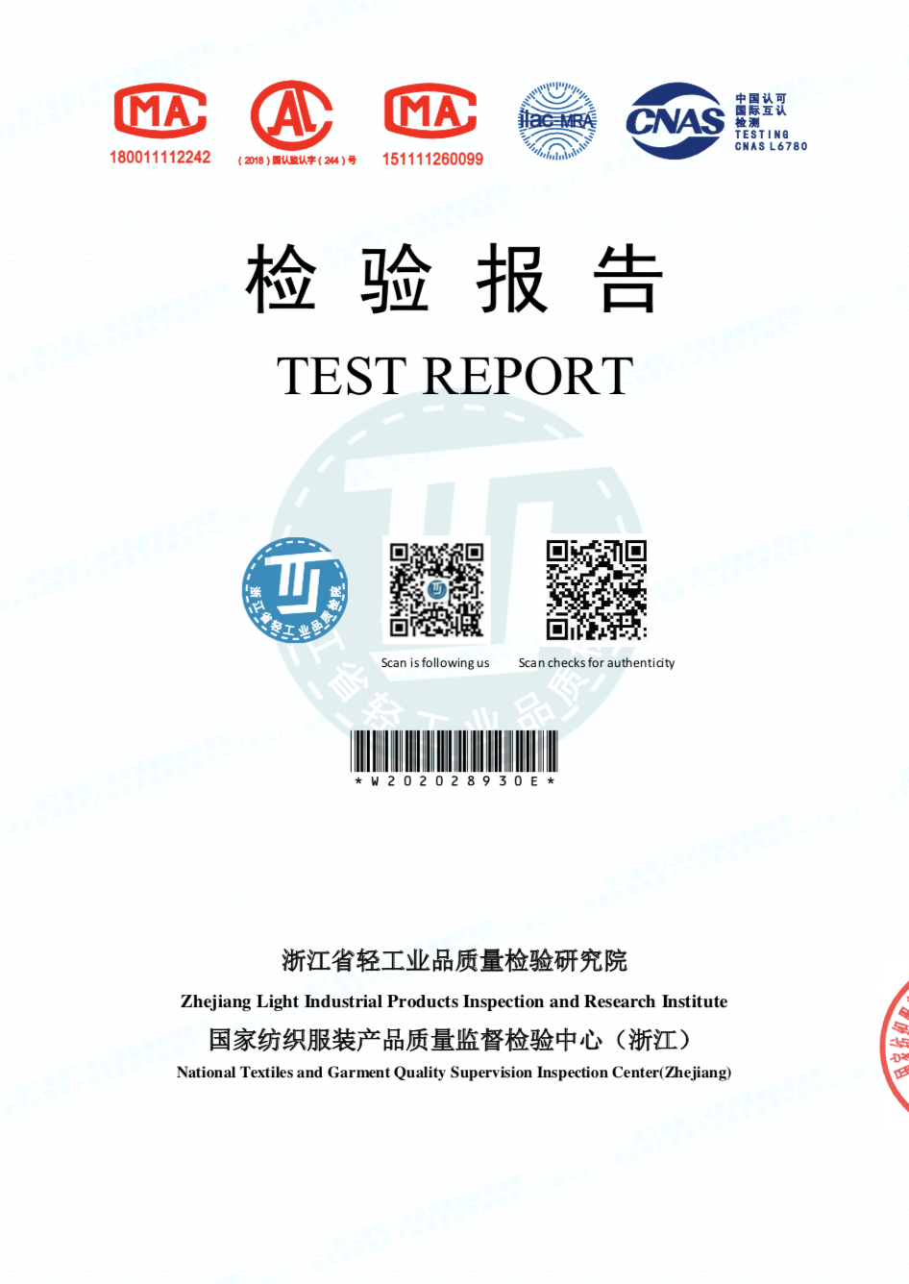
Test Report

Slide 6
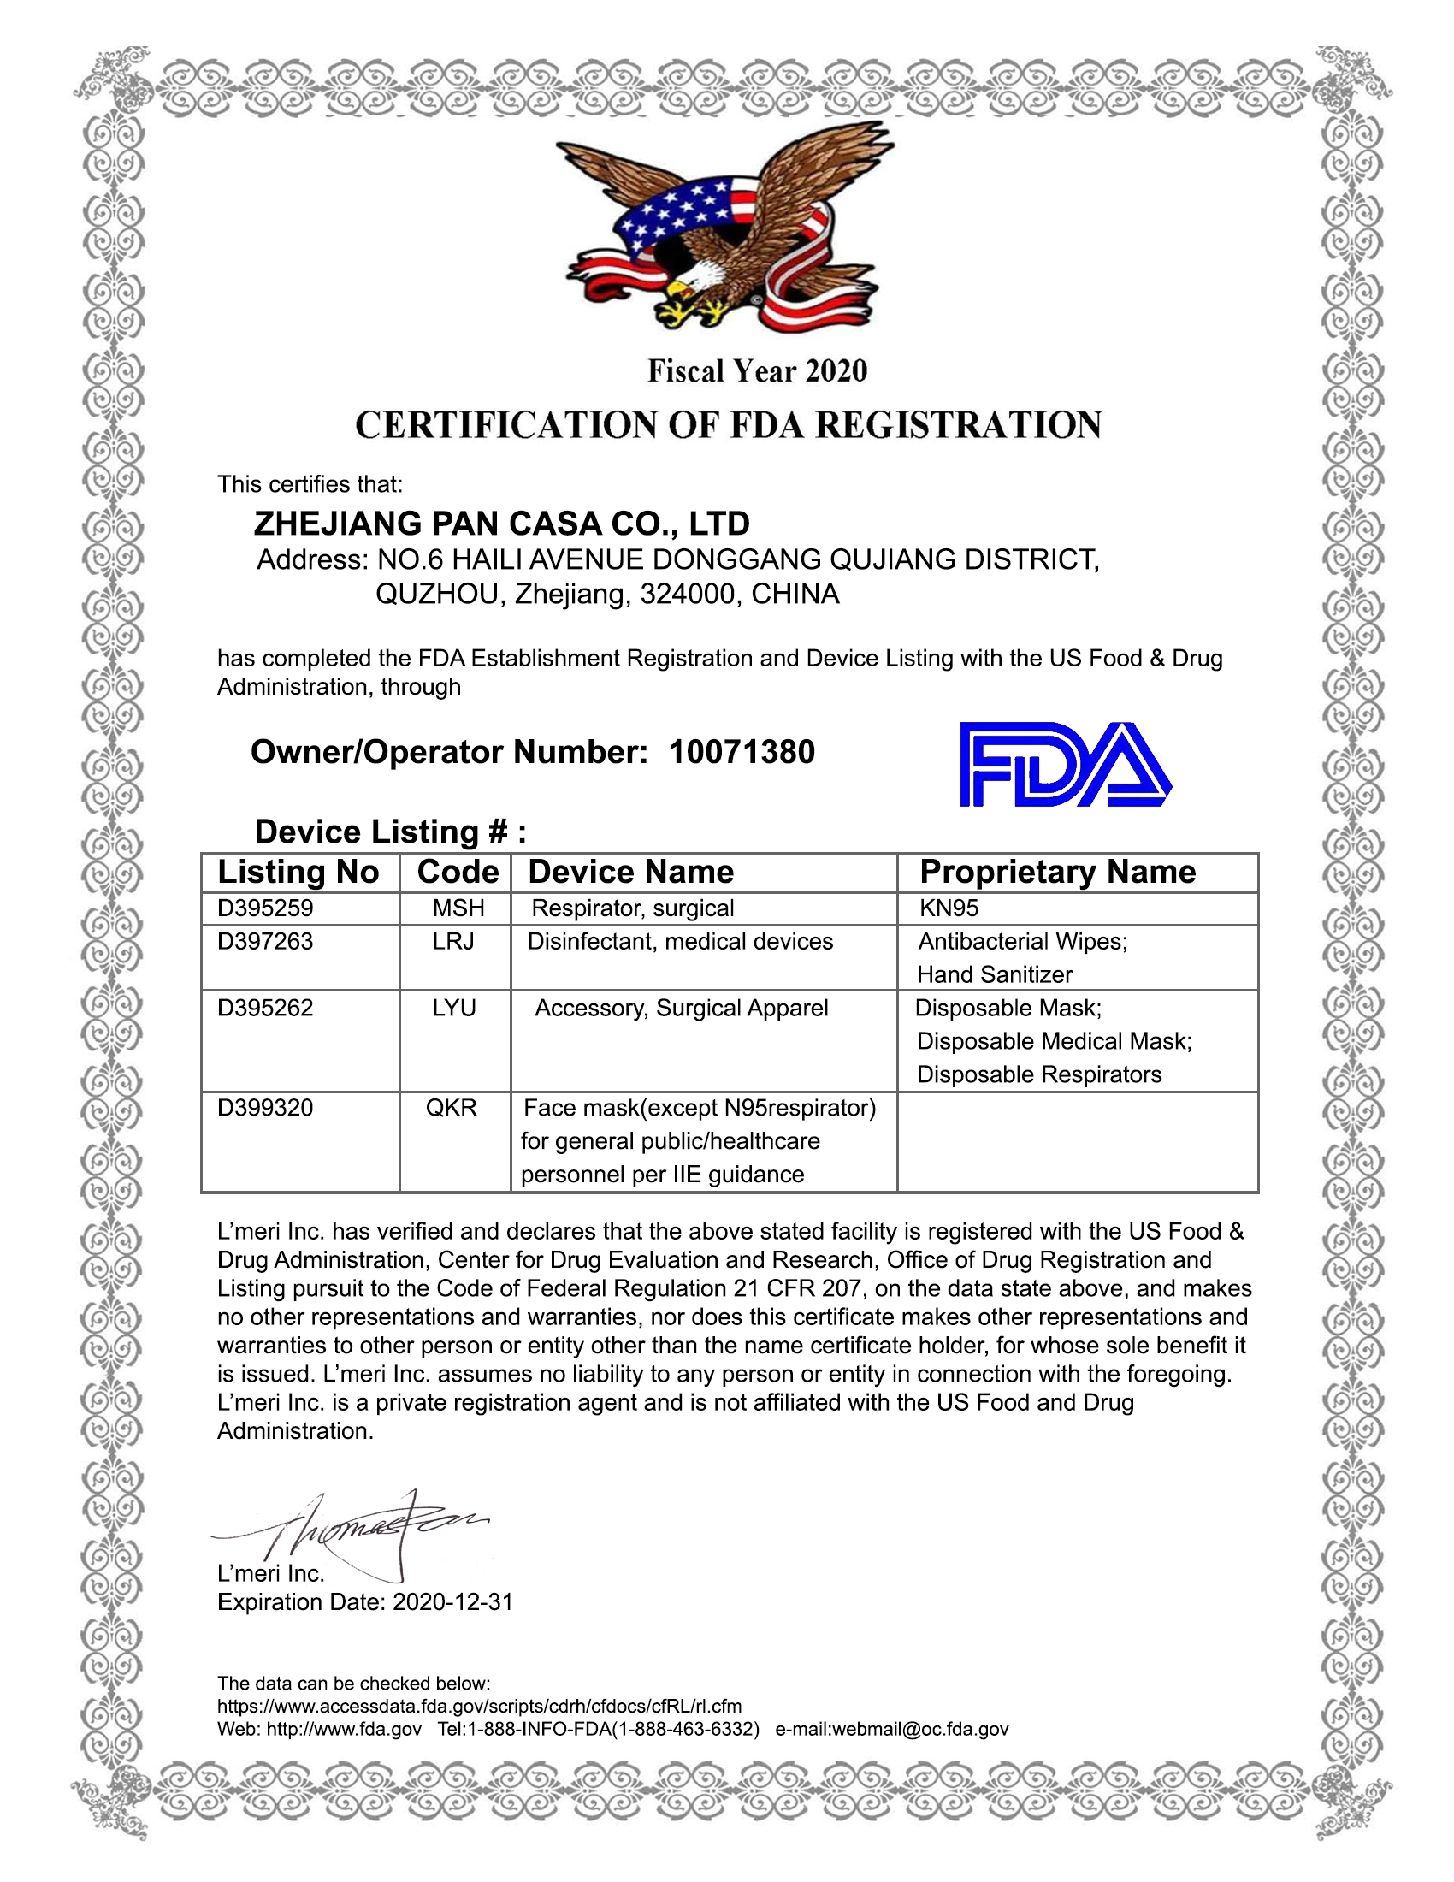
FDA Registration

Slide 7
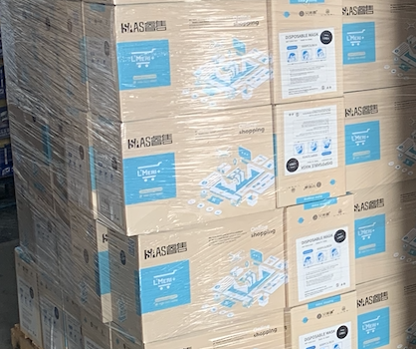
Product Package Info
Inner packaging
Containers/ Carton (Pcs)
50 masks/box
12 boxes/Carton
600 masks/Carton
Carton Dimension: 41 x 23 x 30 cm
G. W.: 3.63 KG
Size: 11.5 x 20 x 10 cm
Weight: 250g
Material: High efficiency filter non-woven fabric
Color: Black

