Slide 1
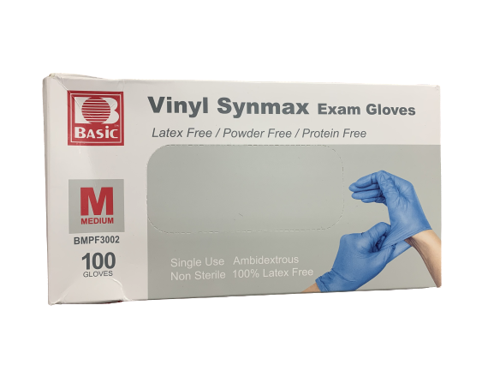
Vinyl Synmax Powder Free Exam Gloves
Key Product Specs:
FDA Approved
Easier donning and longer wearing than vinyl and nitrile gloves
Latex free and PU Coating with no protein, limiting allergy risk
Increased protection, resisting acid, alkali and oil
Available in S, M, L & XL

Slide 2
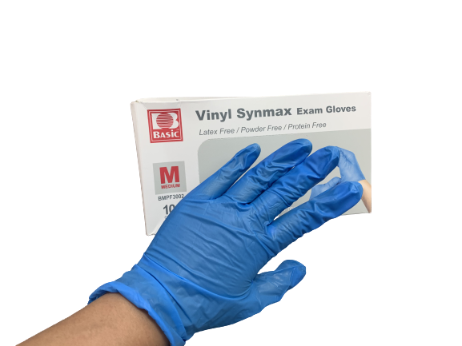
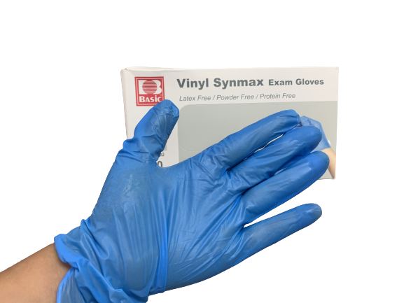
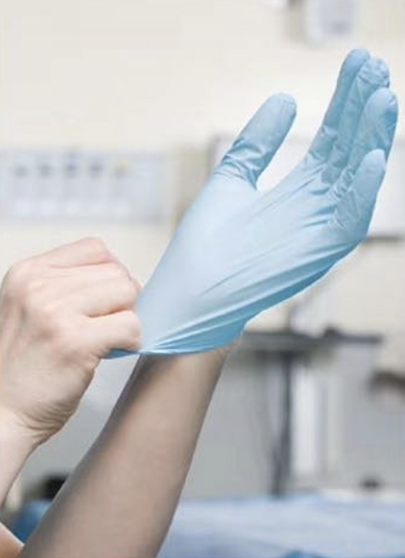
Product Display
Photo

Slide 3
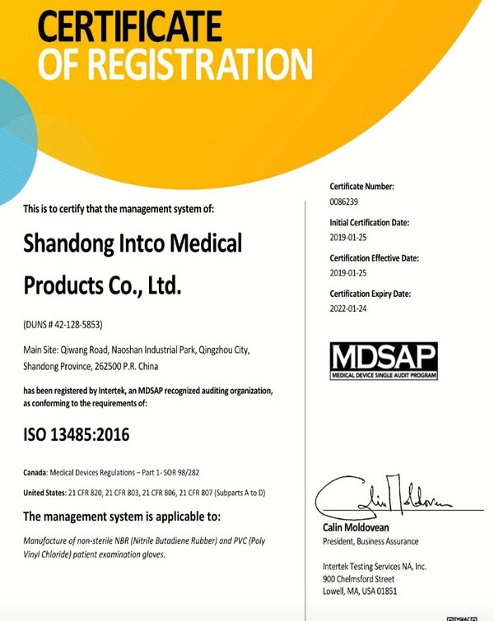
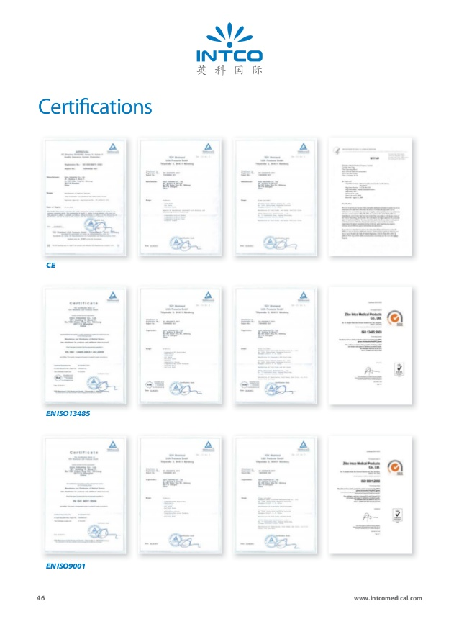
Business & Medical Licenses

Slide 4
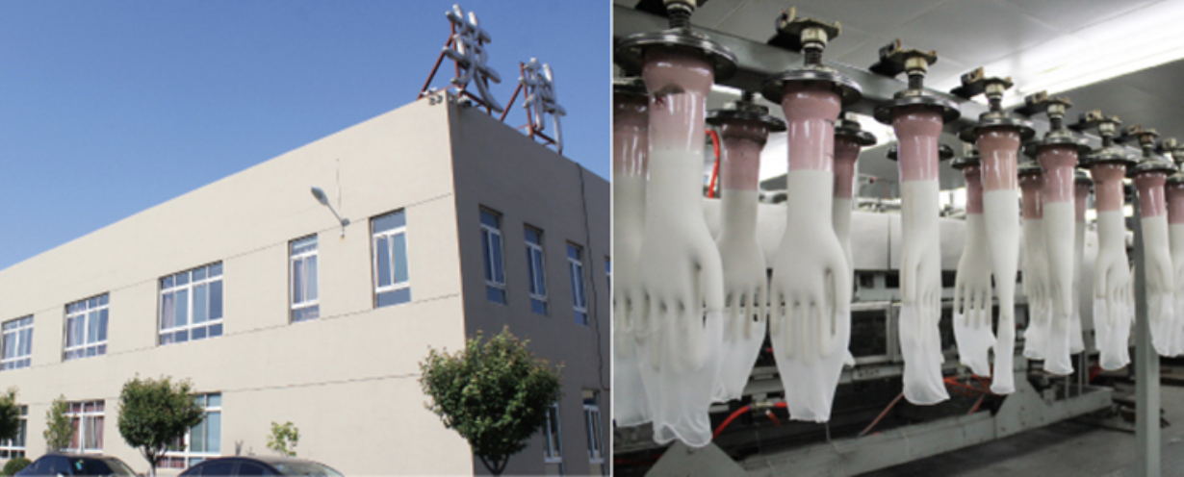
Company Info
Intco Medical is the Chinese leading manufacturer of medical disposable products and durable medical equipment and we have two major marketing centers in Los Angles, USA and Shanghai, China, several sales offices in Canada, Malaysia and Germany as well as four factories separately in Shandong and Jiangsu . Our main businesses cover the R&D, production and sales of disposable medical gloves, wheelchairs, non-woven fabrics, hot/cold therapy, electrodes and other products. Since the establishment of 1990s, we have provided numerous high quality products and services to more than 100 countries and areas around the world.

Slide 5
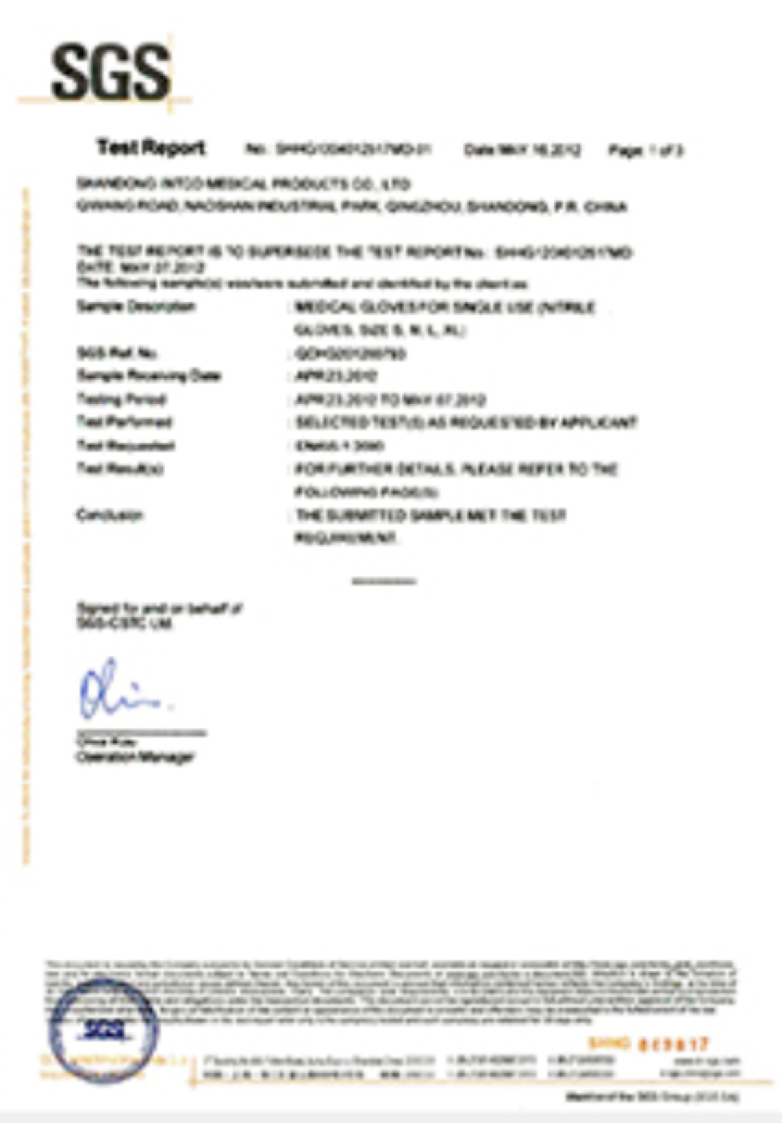
Test Report

Slide 6
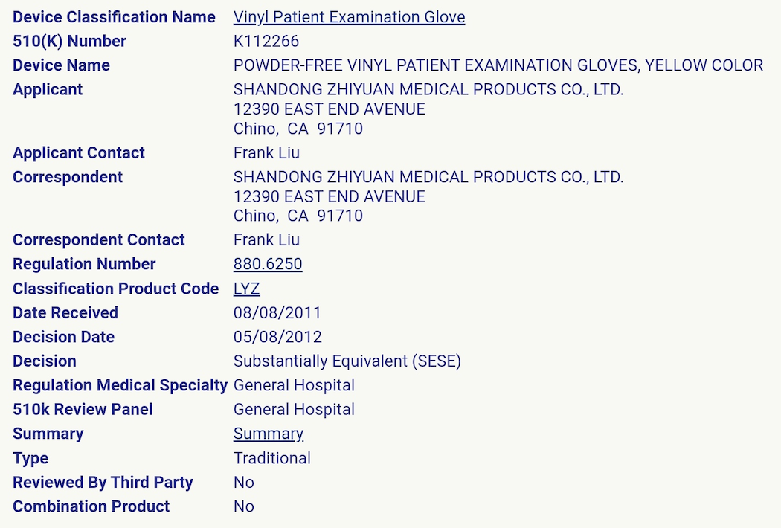
FDA Registration

Slide 7
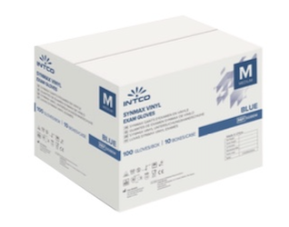
Product Package Info
Inner packaging
Containers/ Carton (Pcs)
Size: 31.5 x 12.5 x 6 cm
Material: Synthetic Vinyl
Weight: 720g
Color: blue
100 pcs per box
10 boxes per case
1000 pcs per case
Carton Dimension: 31.5 x 25.8 x 24.5 cm
G. W.: 7.25KG

