Slide 1
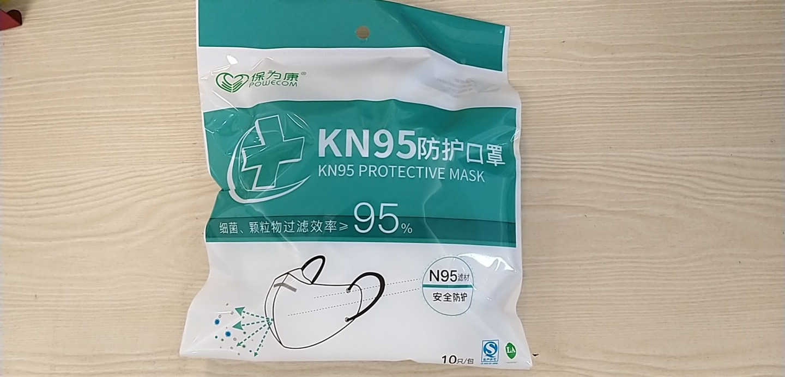
KN95 Protective Masks
Key Product Specs:
EUA Registered
Filter Efficiency >=95%

Slide 2
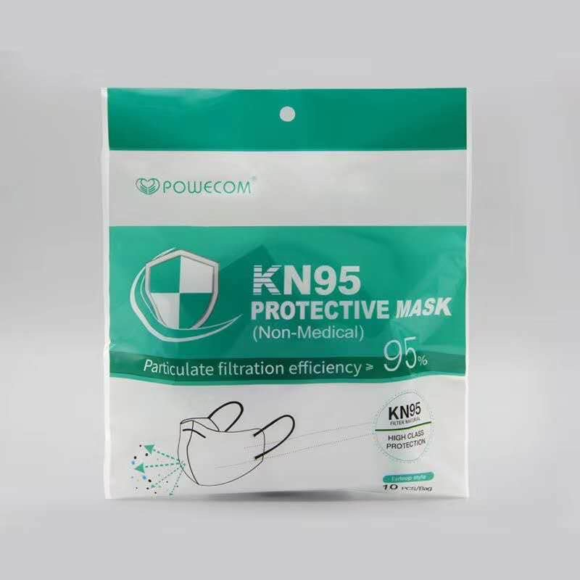
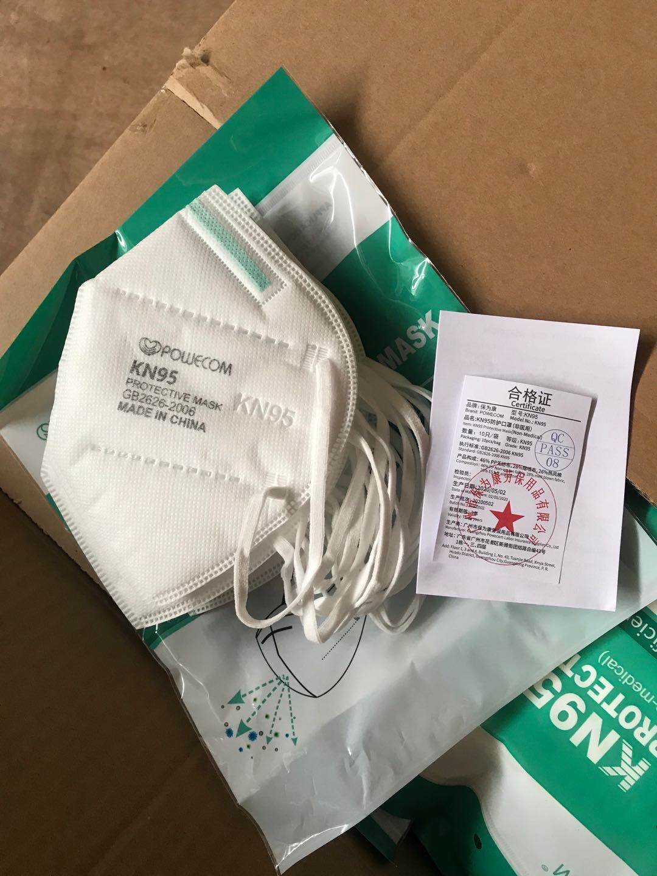
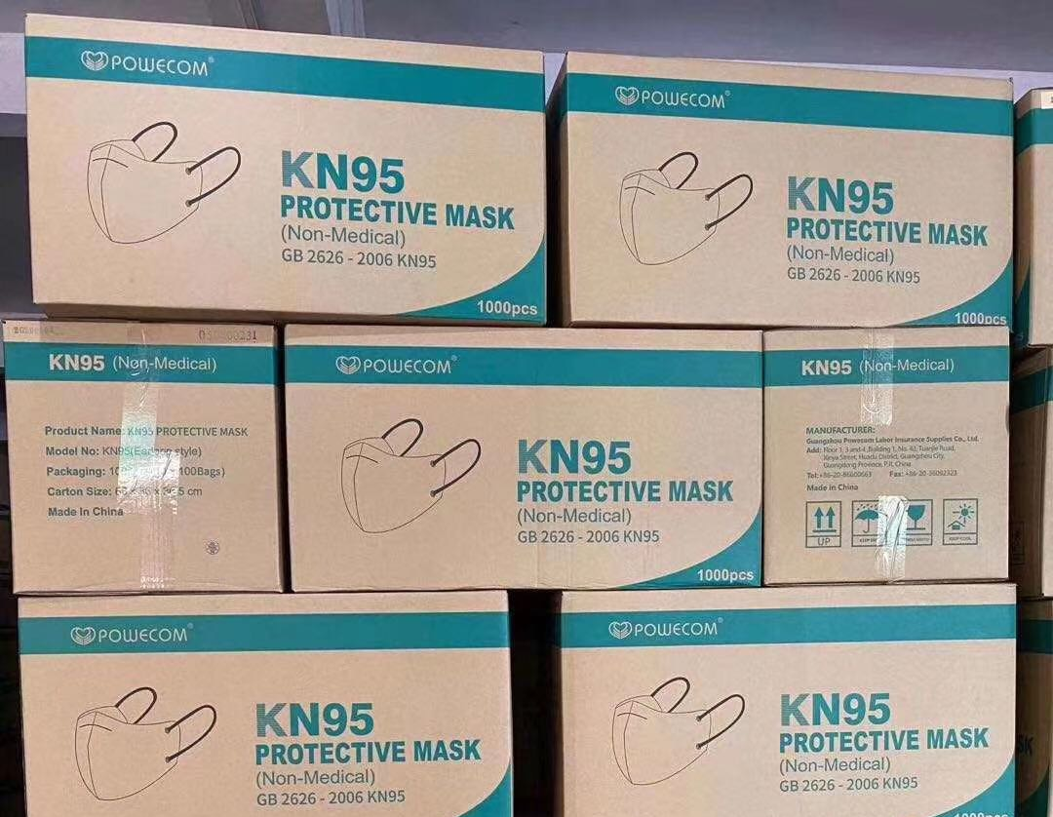
Product Display
Photo
Detail
Packing

Slide 3
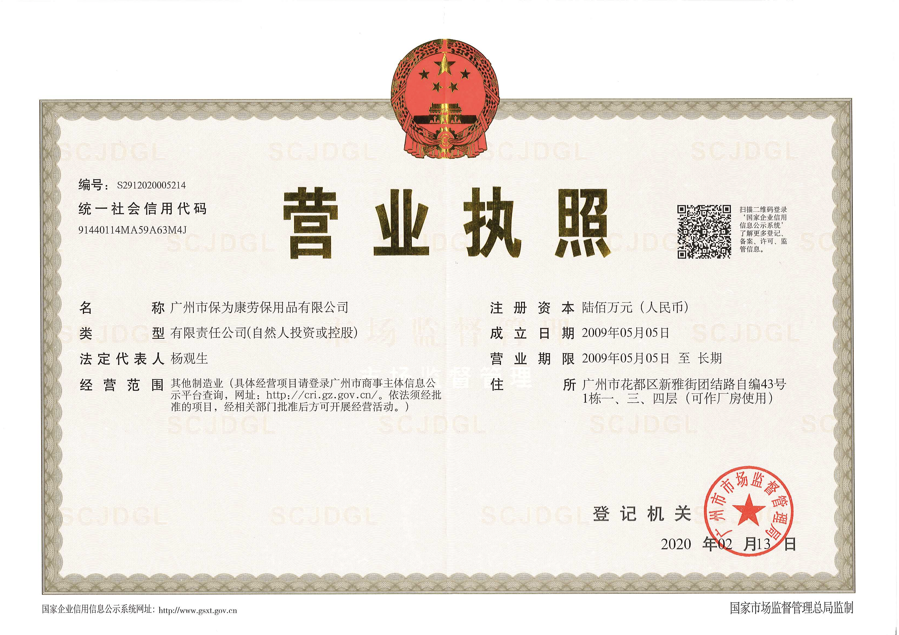
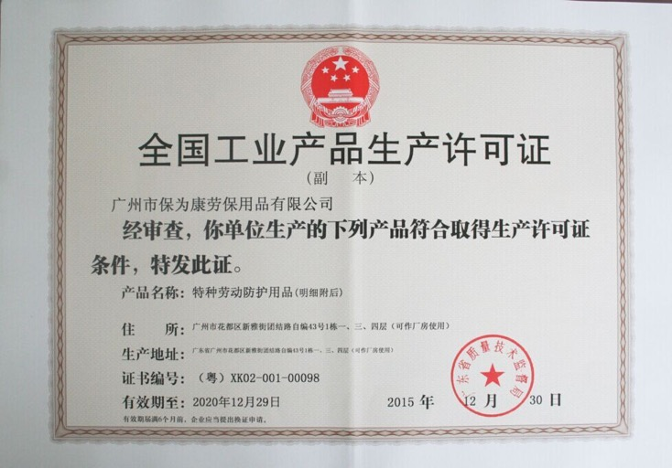
Business & Medical Licenses

Slide 4
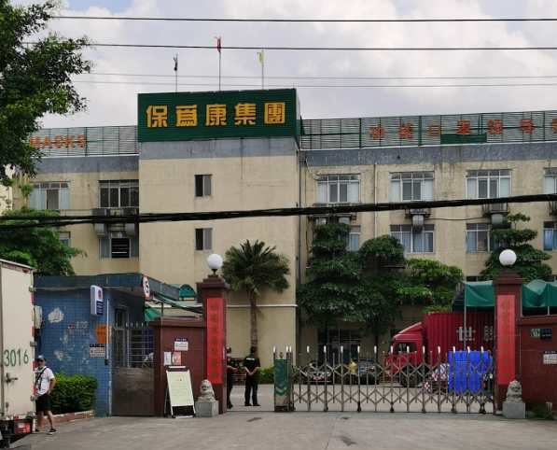
Company Info
Guangzhou Powecom Labor Insurance Supplies Co., Ltd founded in 2009, is a leader in functional masks and products enjoying a good reputation for quality. Powecom production bases are currently consisted of Powecom Factory #1 in Guangzhou and Powecom Factory #2 (branch) in Pingxi Village.

Slide 5
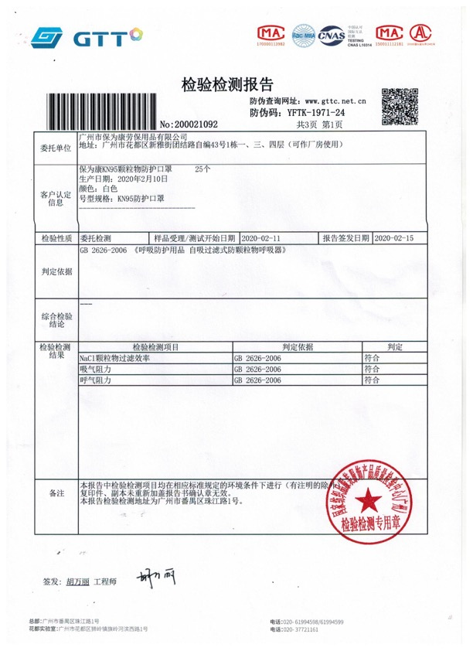
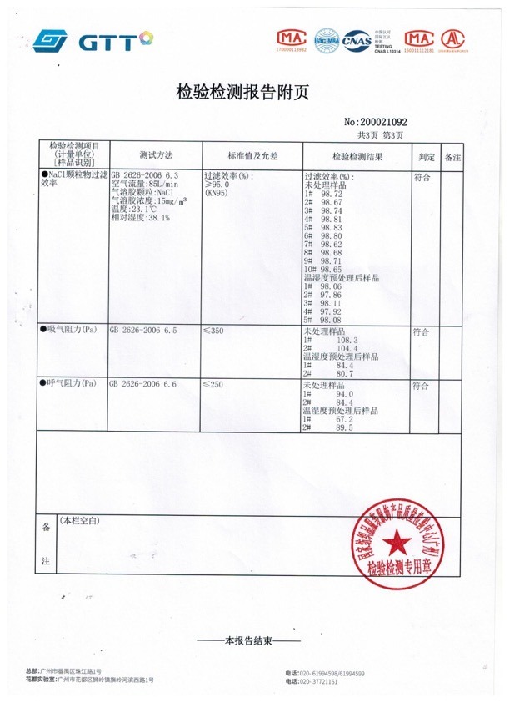
Test Report

Slide 6
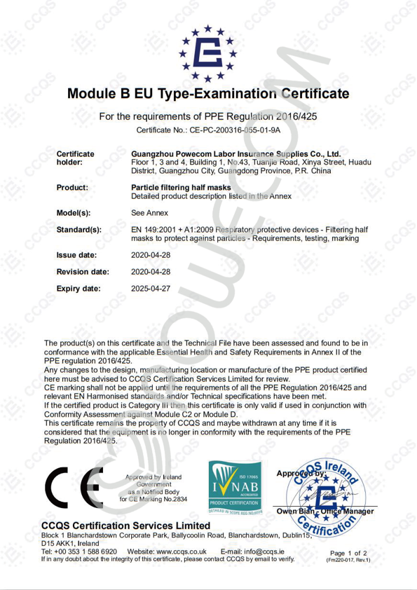
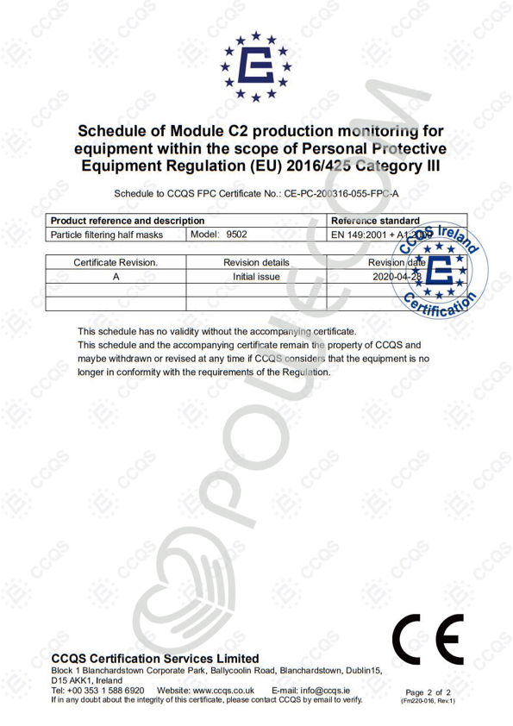
EUA Registration

Slide 7
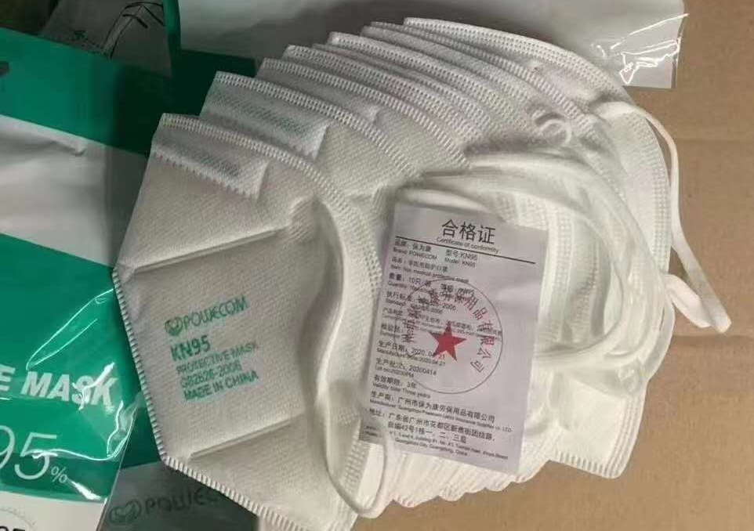
Product Package Info
10 pcs / bag
100 bags / Carton (1000Pcs)
Size:
Material:
Color: white
Weight:
10 pcs per bag, 100 bags per Carton
(1000pcs/carton)
Carton Dimension: 68*36*36.5 cm
G. W.:

