Slide 1
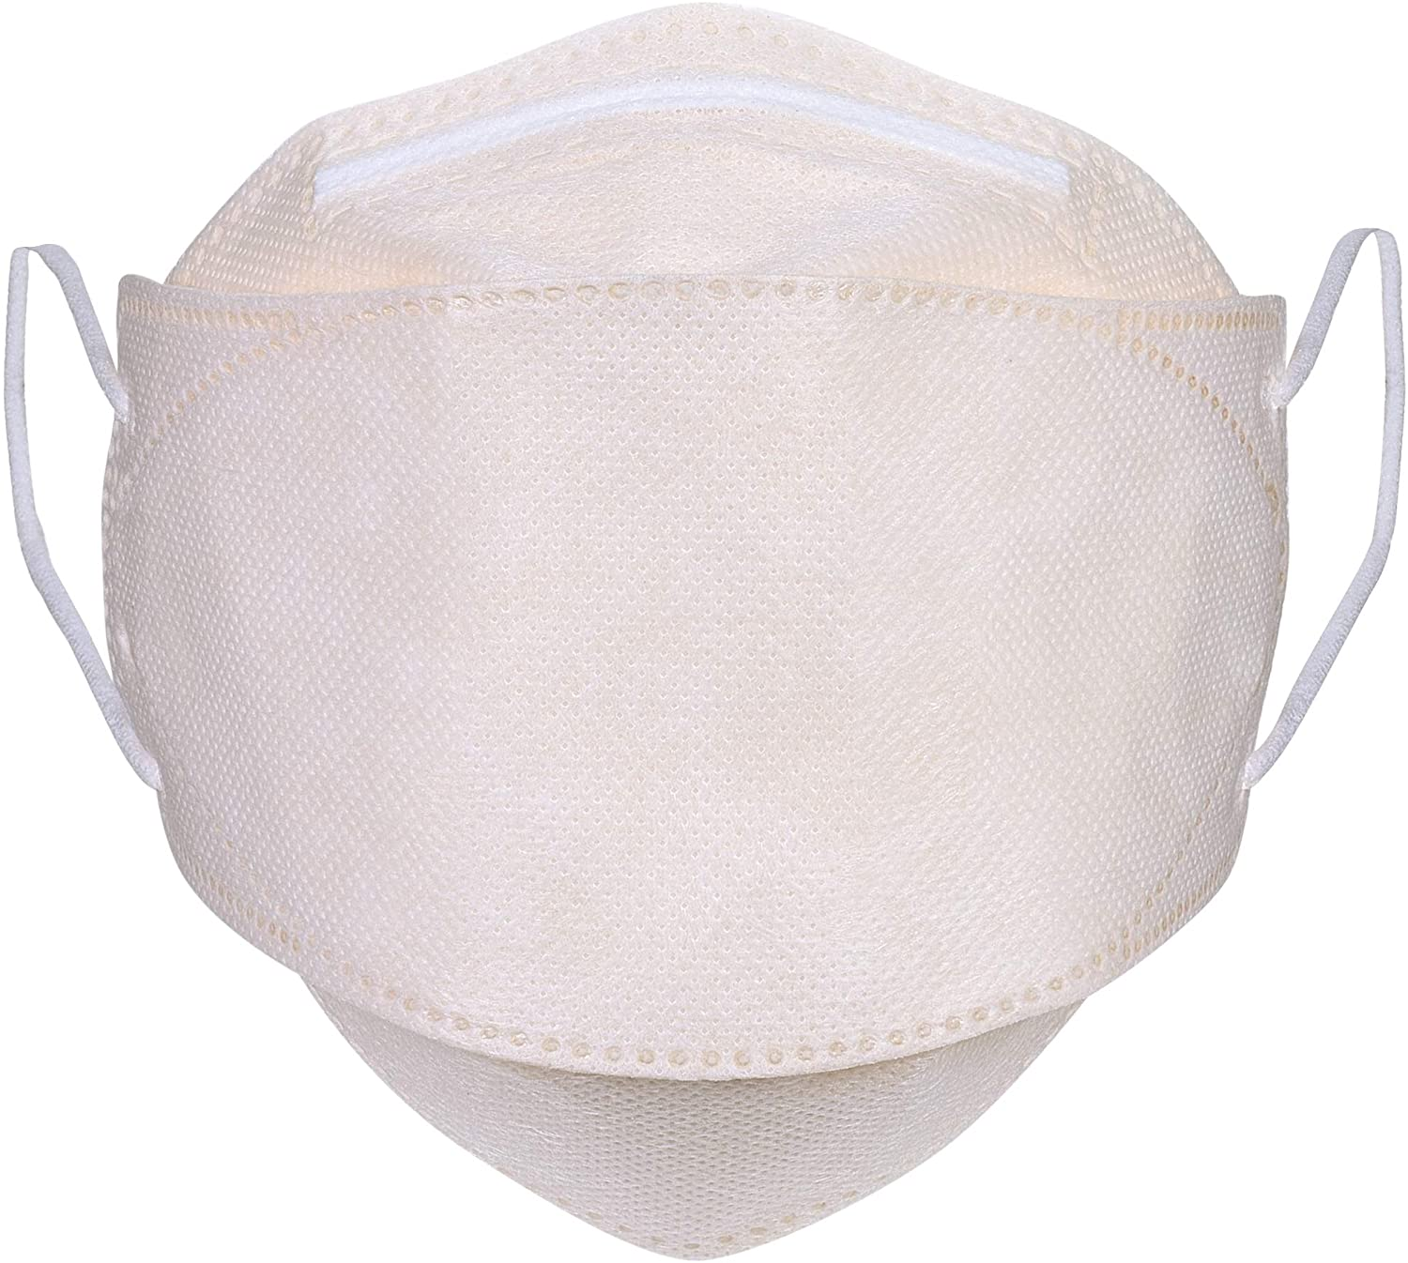
Korean KN95 Masks
Key Product Specs:
Wider 3D shape for more comfort
4 layer filtration for high BFE rate > 95%
Breathable
White

Slide 2
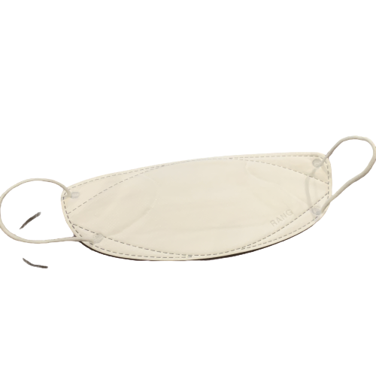
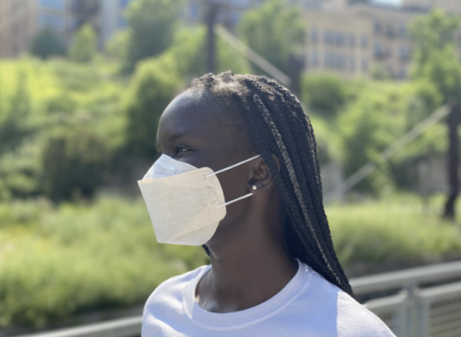
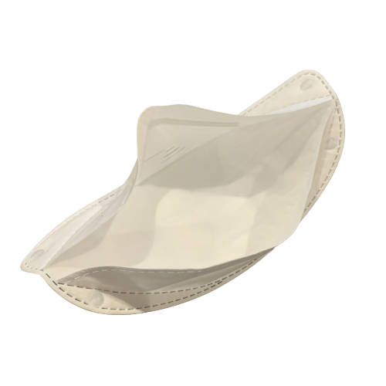
Product Display
Photo

Slide 3
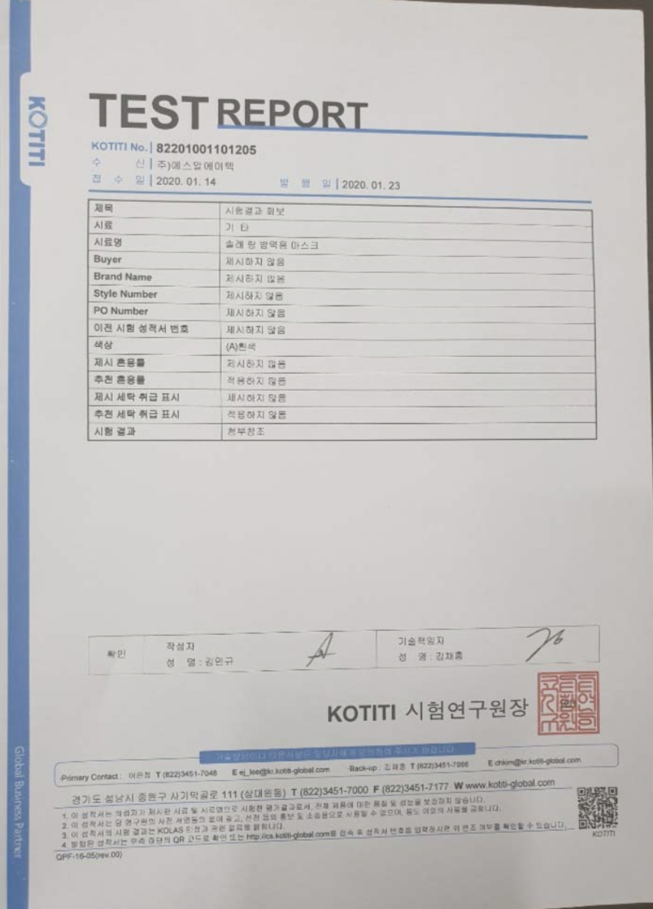
Test Report

Slide 4
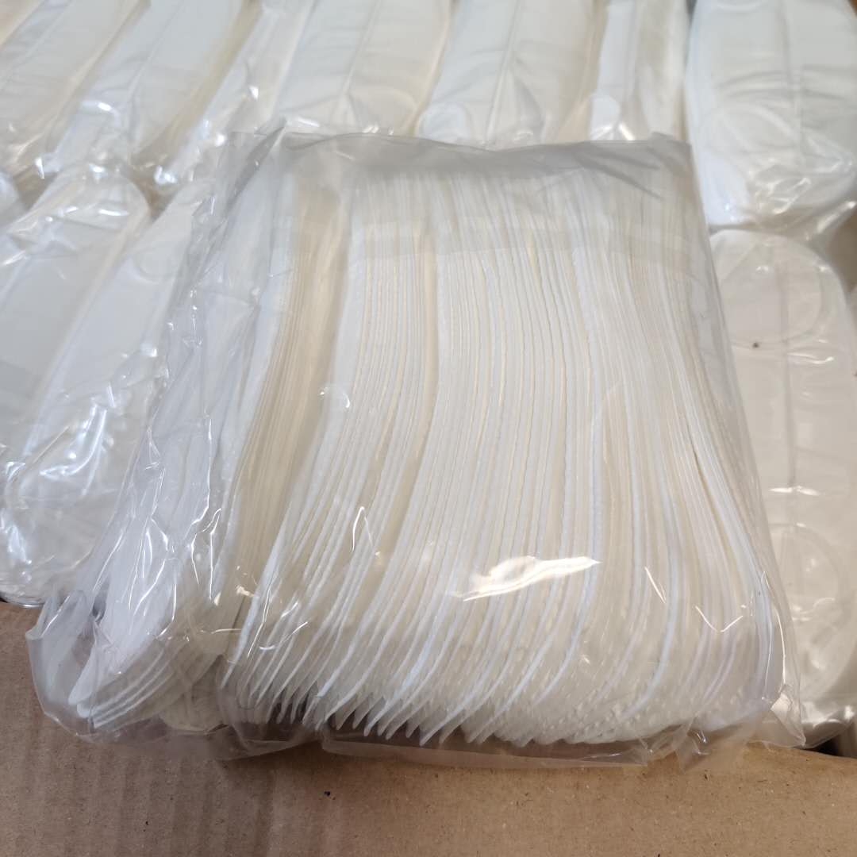
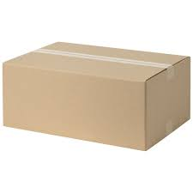
Product Package Info
Inner packaging
Containers/ Carton (Pcs)
Size: 22 x 10 x 10 cm / bag
Material: Non-woven
Weight: 200 g
Color: White
50 pcs per bag
40 bags per case
2000 per case
G. W.: 8 KG

