Slide 1
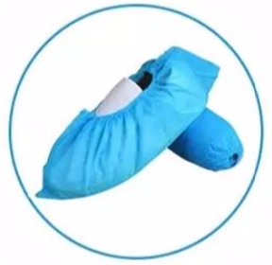
FMEC Shoe Covers
Key Product Specs:
FDA Registered
Slip resistant with uneven surface
Good elasticity with double elastic band
Good toughness, resist tearing, and durable

Slide 2
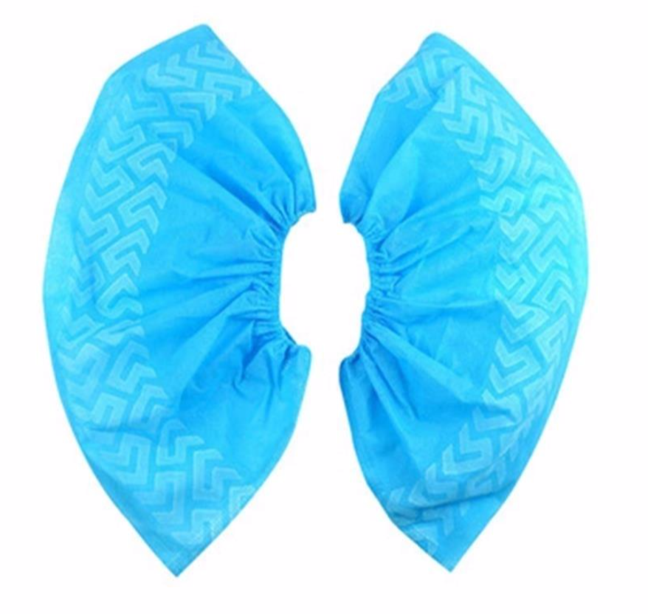
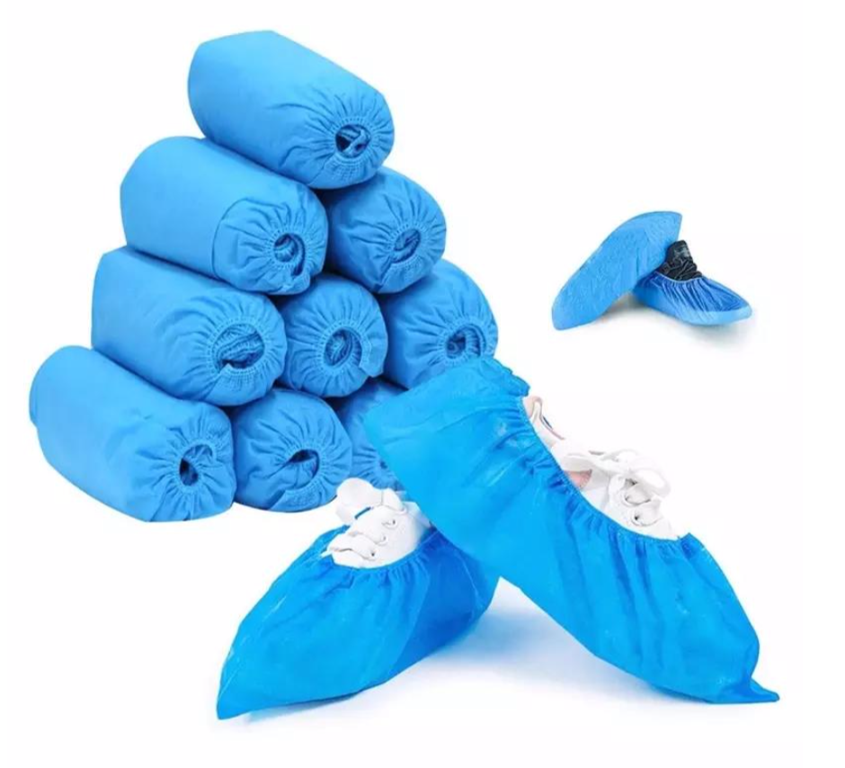
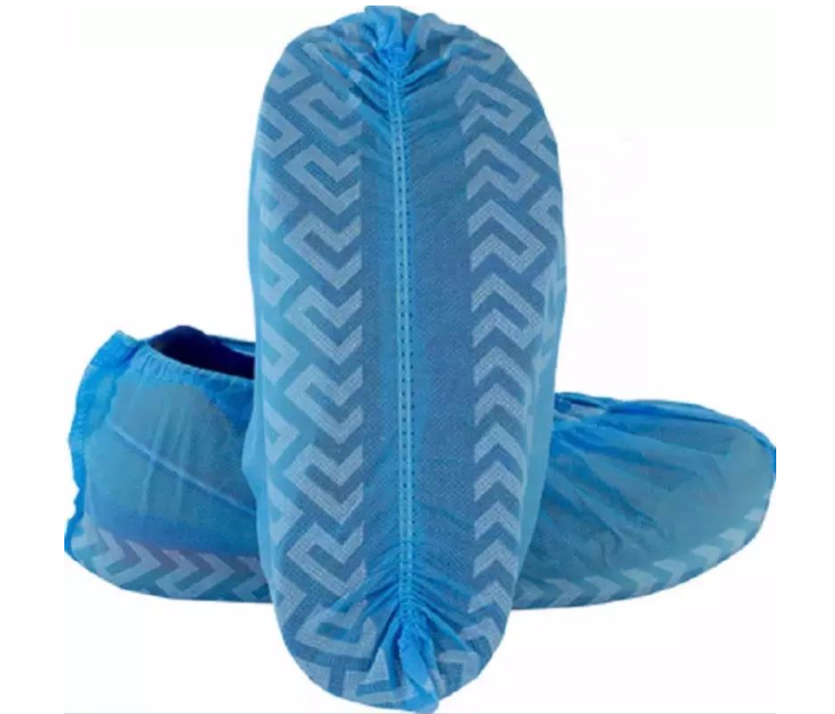
Product Display
Photo

Slide 3
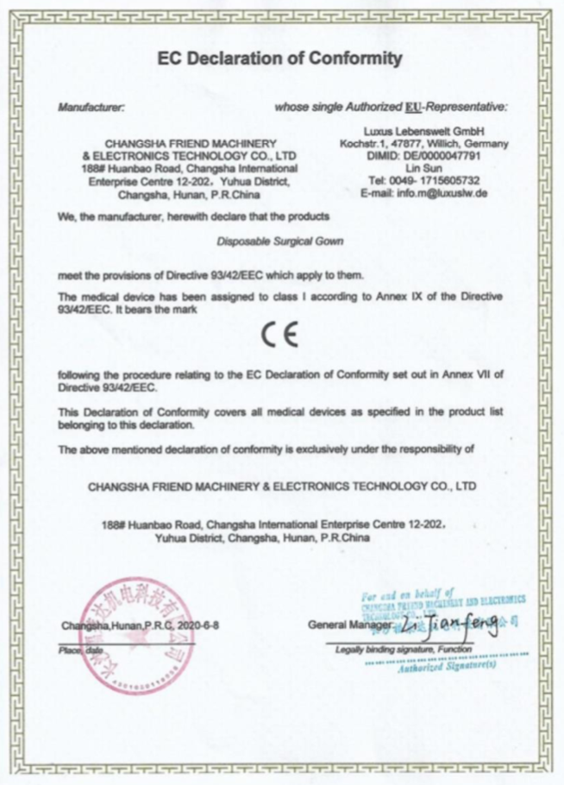
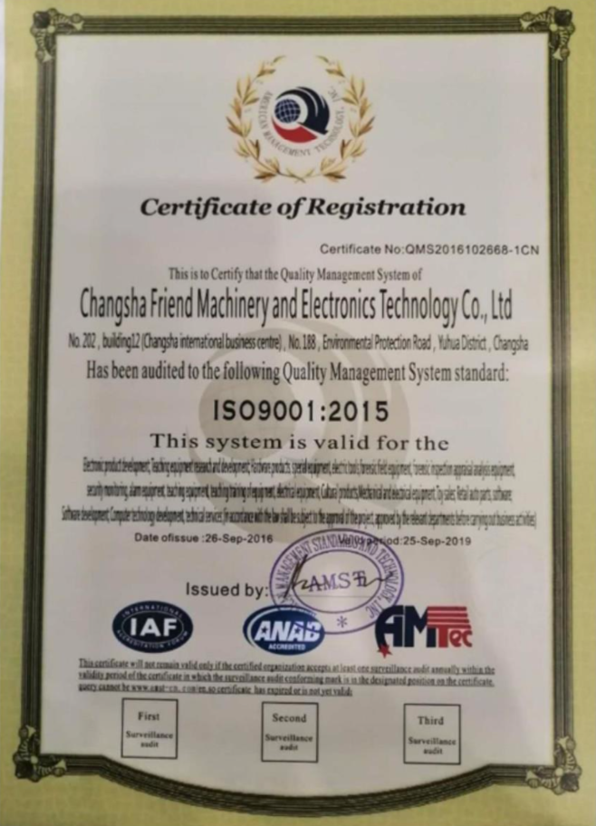
Business & Medical Licenses

Slide 4
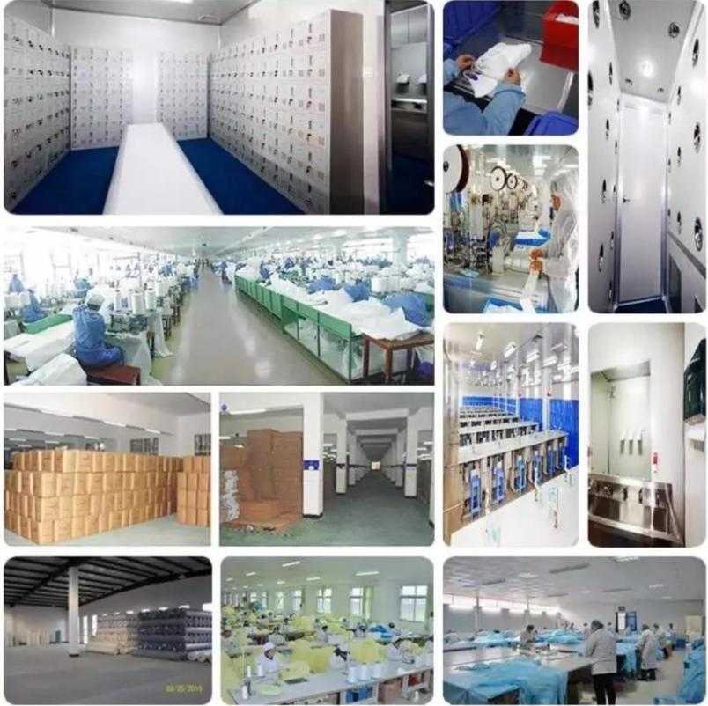
Company Info
Changsha Friend Machinery & Electronics Technology Co., TLD (FMEC) is founded in 2007. It is a comprehensive high-tech enterprise integrating the production, design and sales of industrial and medical protective products, as well as the trade-type of electromechanical products. Its mission is to realize responsibility, health and harmony in one.

Slide 5
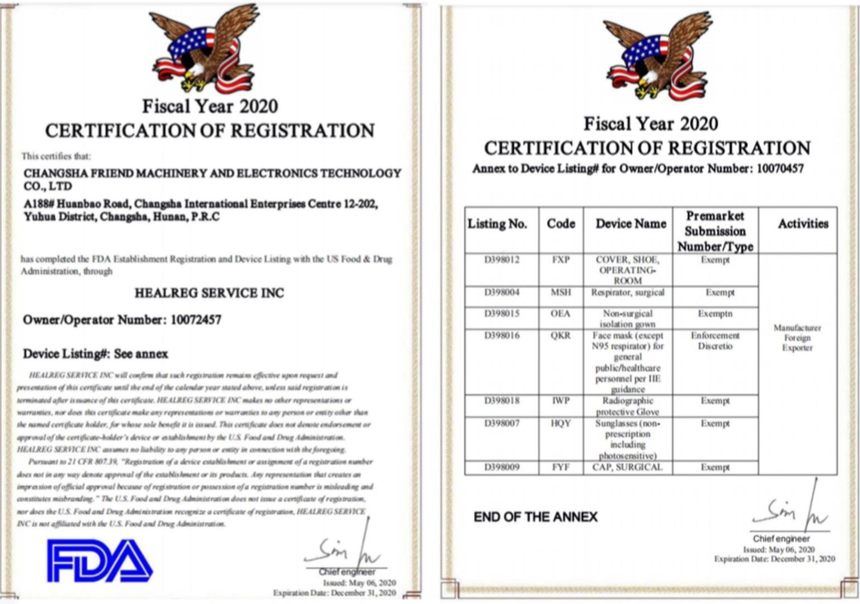
FDA Registration

Slide 6
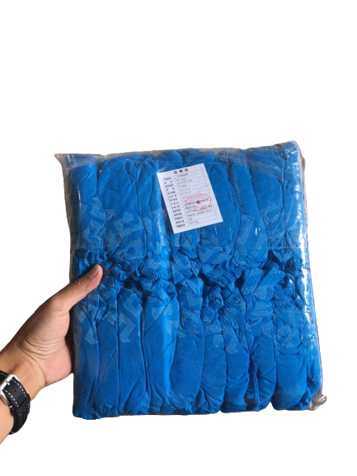
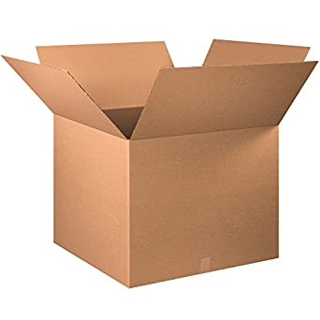
Product Package Info
Inner packaging
Containers/ Carton (Pcs)
20 pcs per bag
100 bags per Carton
2000 pcs per Carton
G. W.: 8.5 KG
Size: 15 x 37 cm / pcs
Material: Non-Woven Fabric
Weight: 4g/pcs
Color: Blue

