Slide 1

Disposable Protective Clothing For Medical Use
Key Product Specs:
FDA Registered
Occupational Protective Clothing, special for epidemic area
Effective antibacterial in preventing air or liquid transmission of the virus
Composite Nonwoven Material: thick and durable/ no smell/ waterproof and breathable/good tensile strength

Slide 2
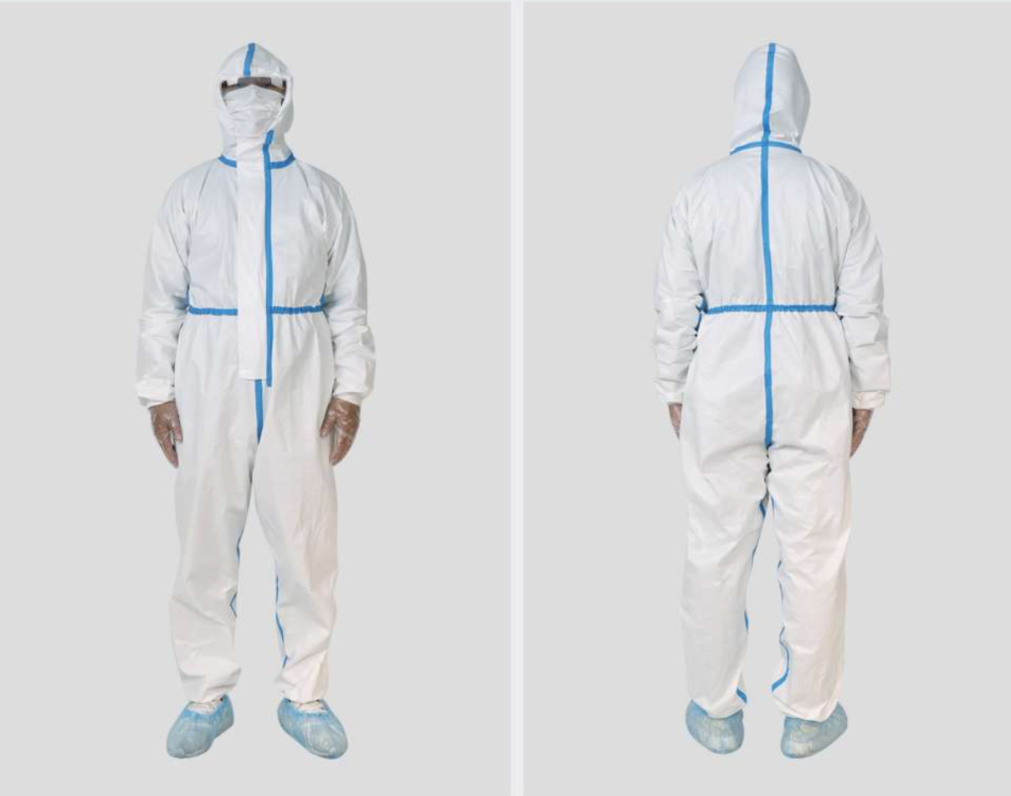
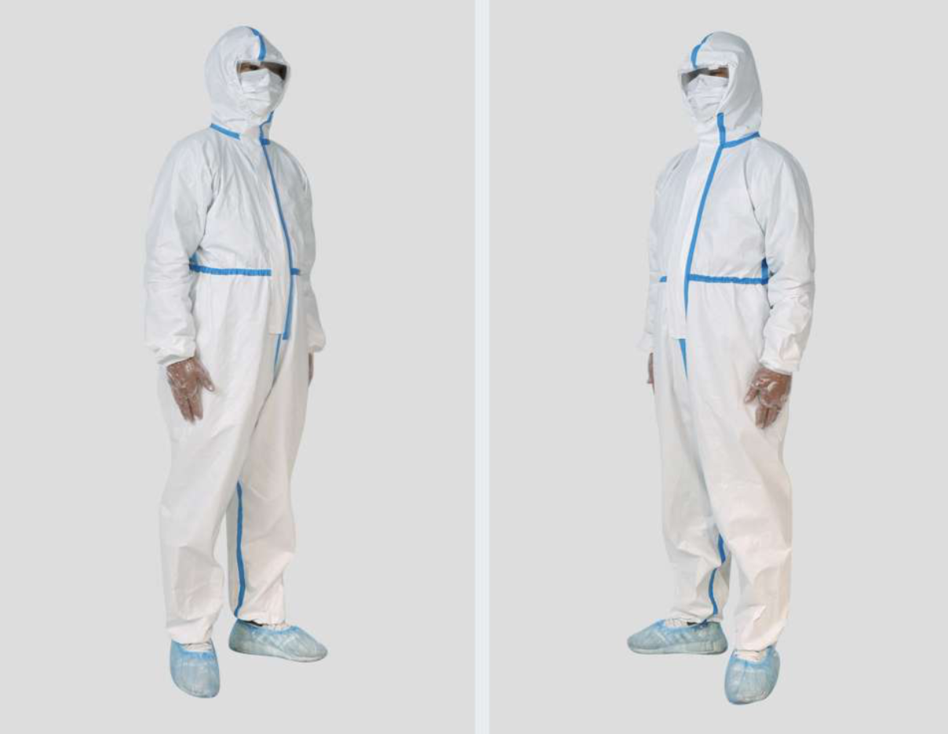
Product Display
Photo

Slide 3
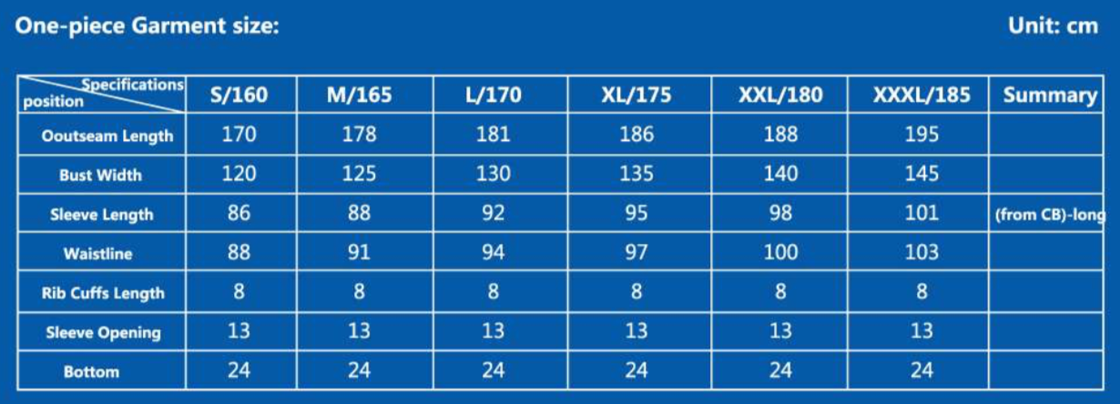
Product Information
Model: Non Sterile One-piece Garment
Color: White
Size：

Slide 4
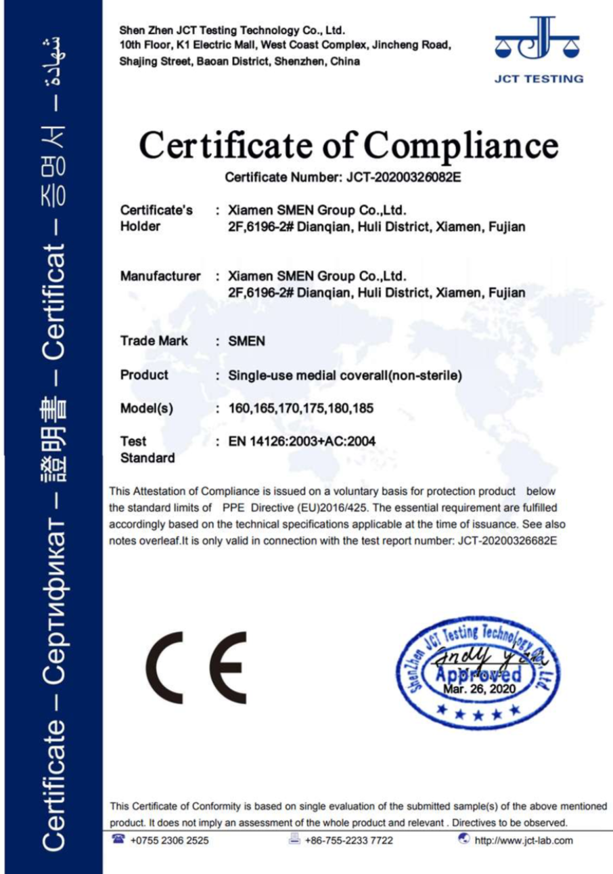
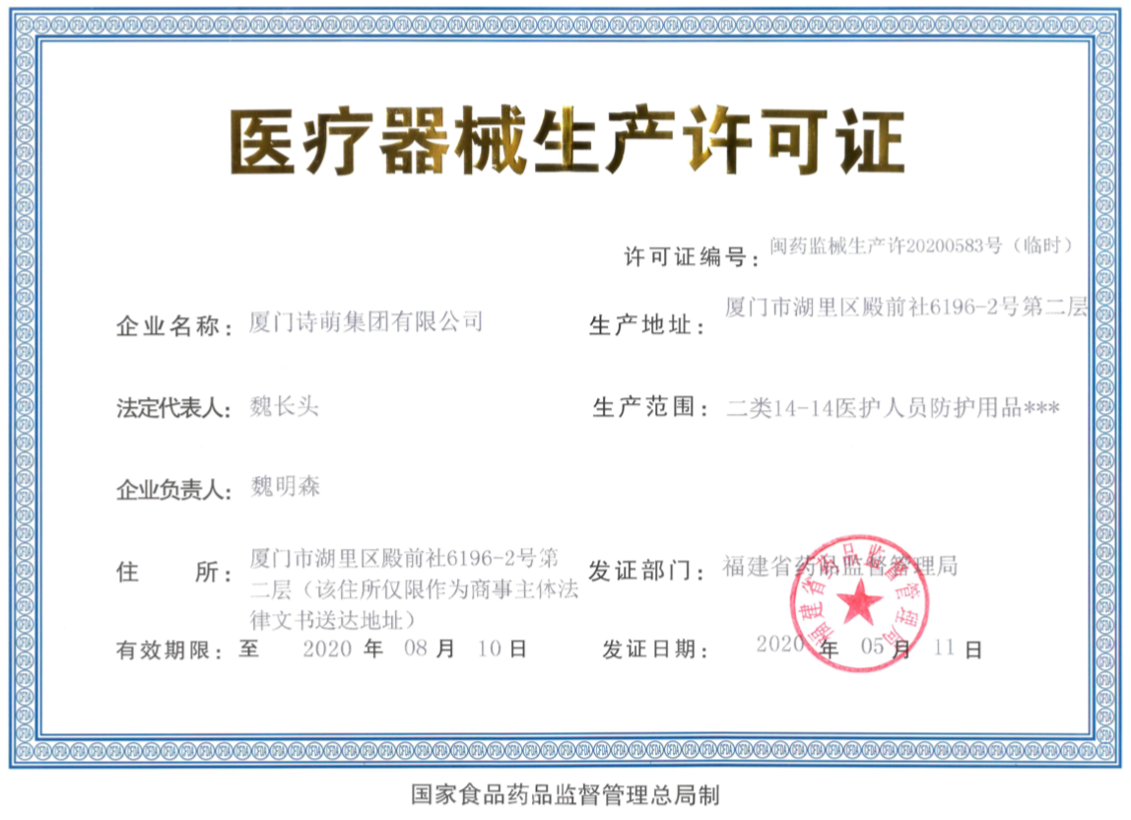
Business & Medical Licenses

Slide 5
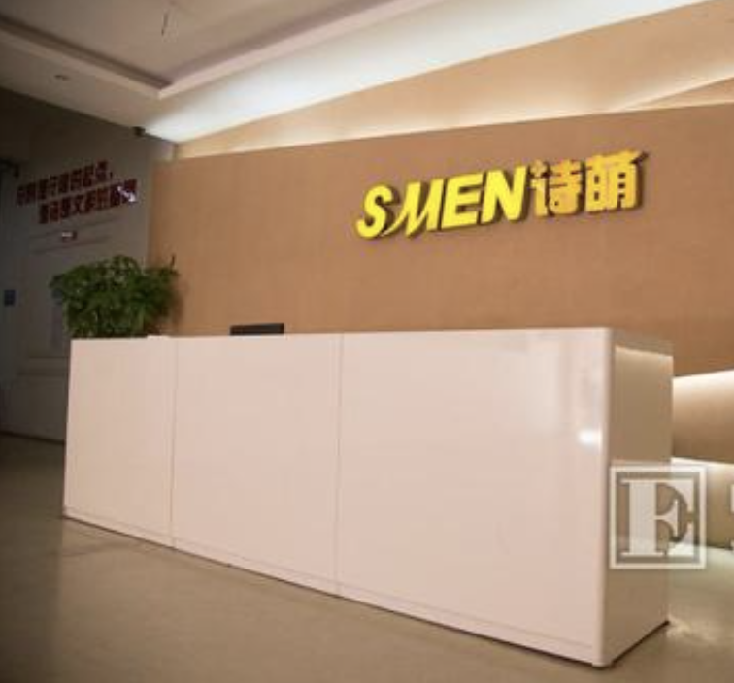
Company Info
Xiamen Smen Group Co., Ltd. a comprehensive apparel company integrating independent research and development, production, sales and service since the year of 2006. There are modern office areas and production plants in Fujian, China, equipped with professional design, production and sales teams, and introduces international advanced management experience into every process. The factory is registered with medical license to produce Non sterile Garments, supporting and contributing for healthcare industry and global pandemics

Slide 6
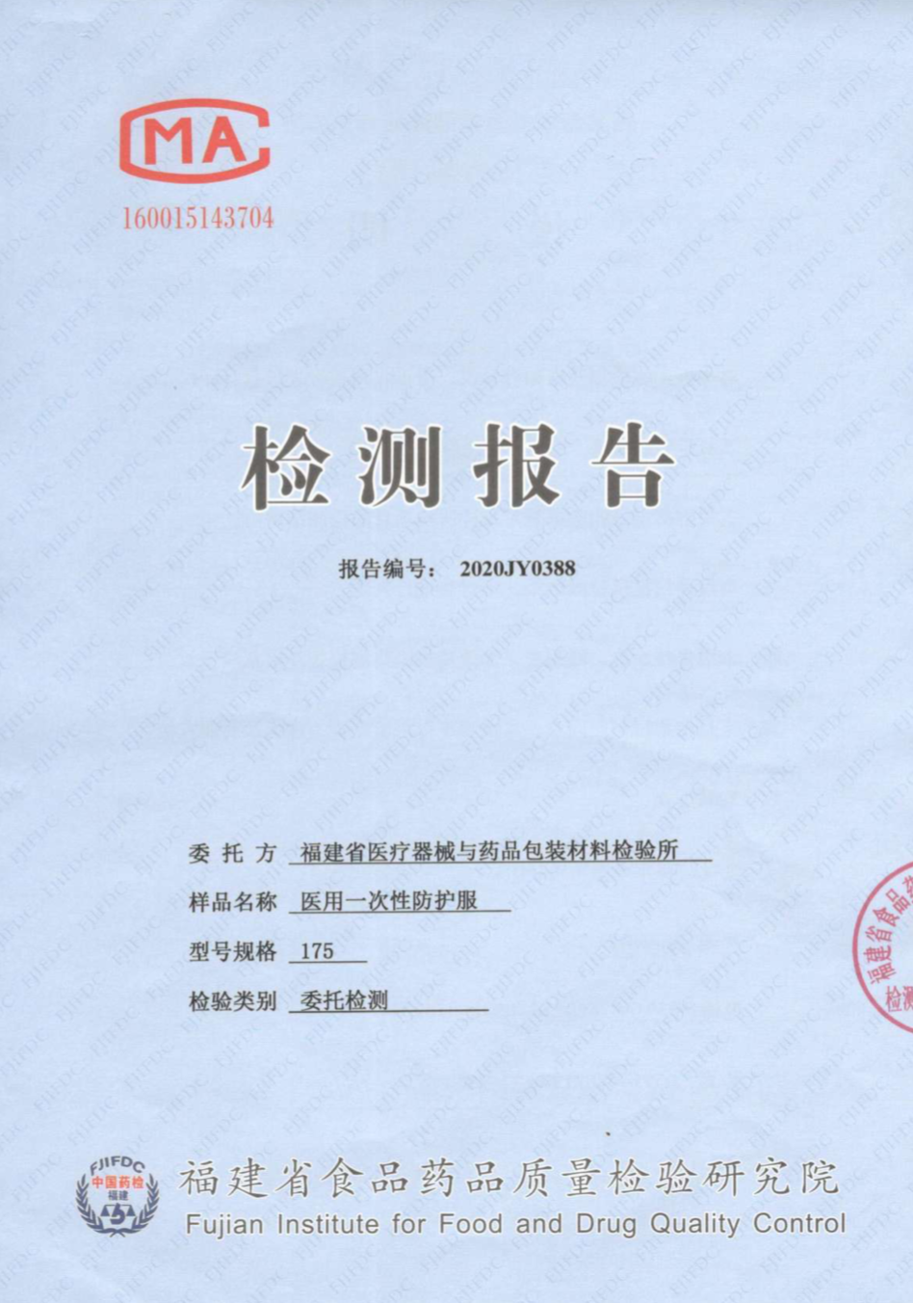
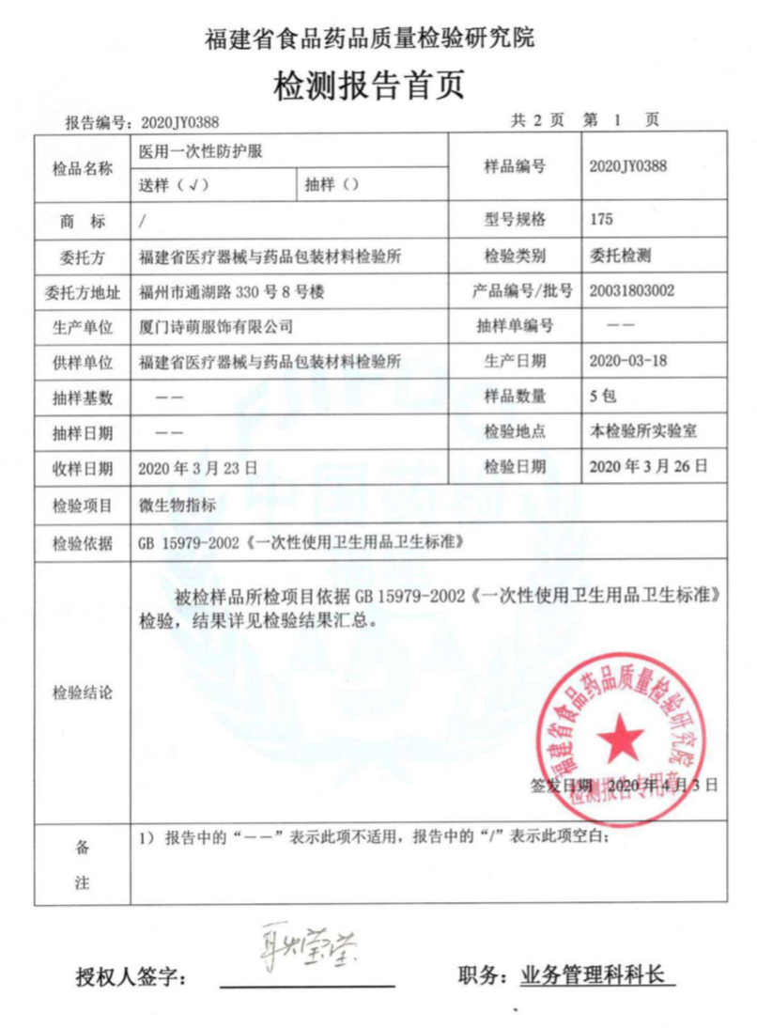
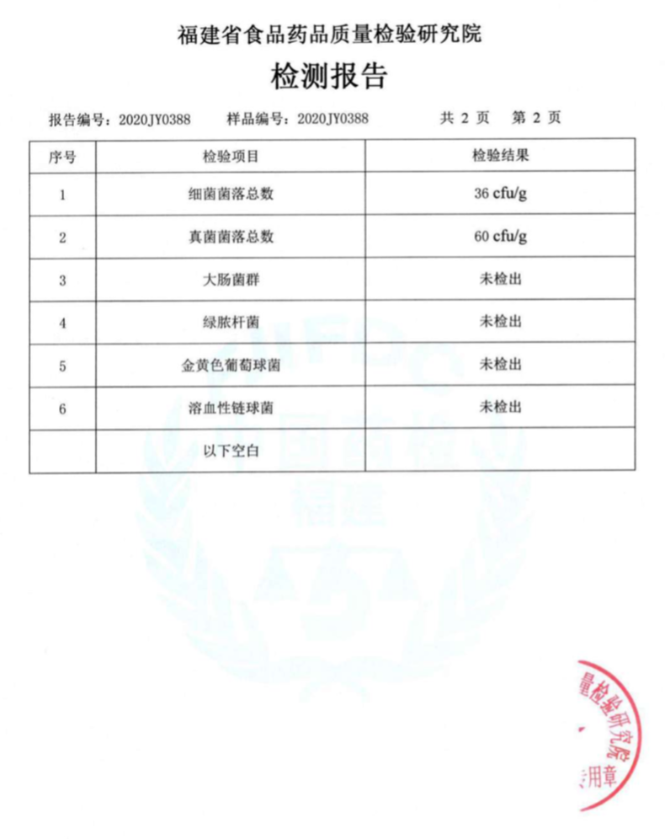
Test Report

Slide 7
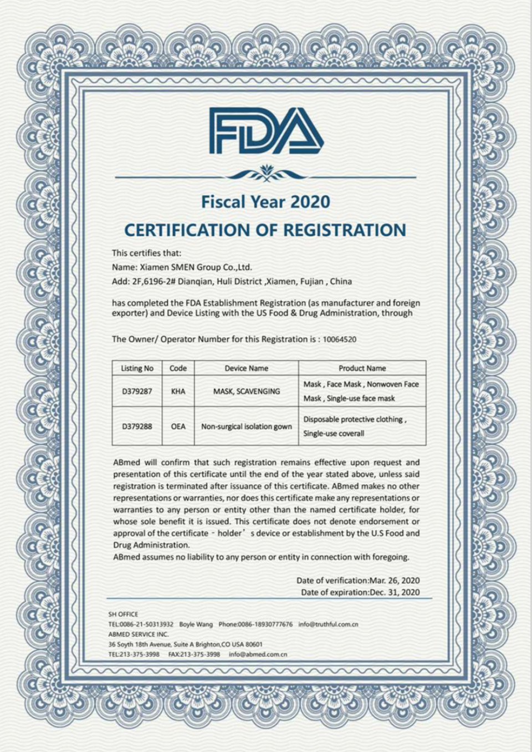
FDA Registration

Slide 8
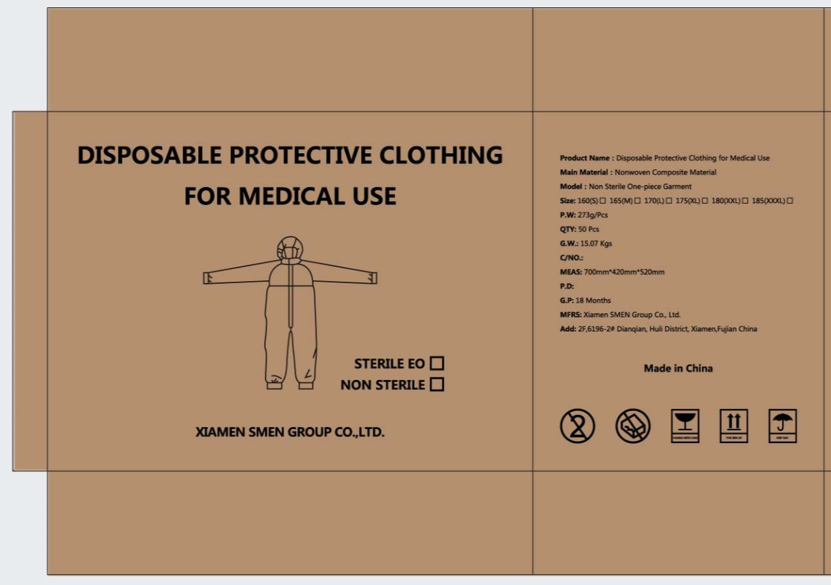
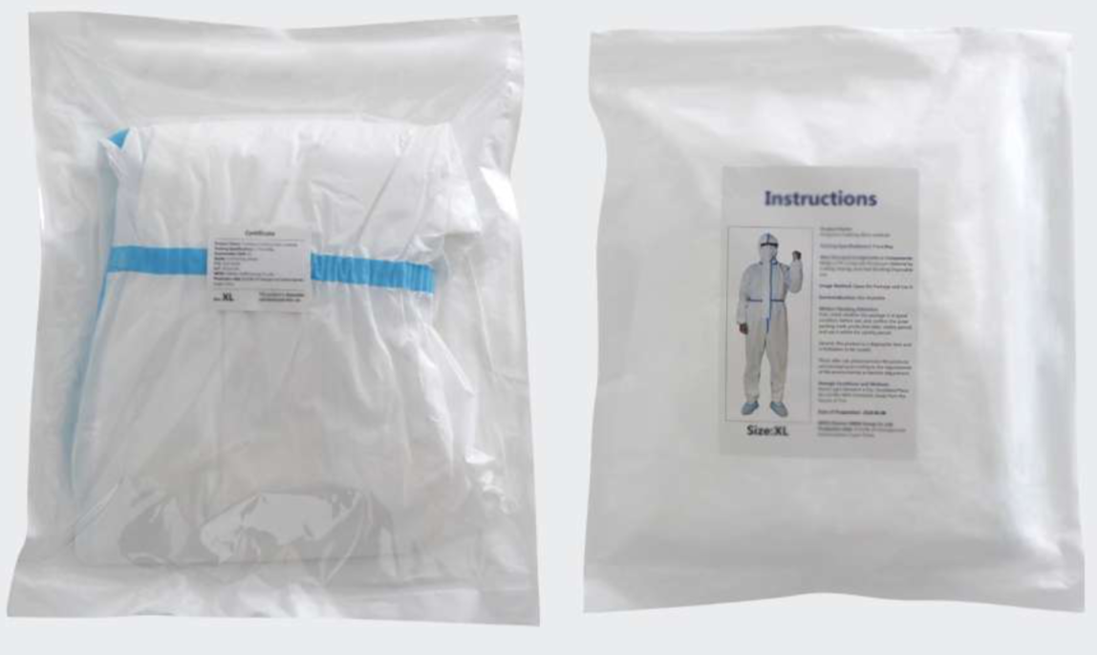
Product Package Info
Inner packaging
1 Carton (50 Pcs)
Size: 37 * 43cm
Material: Composite Nonwoven Material
Color: White
Weight: 273g
50 pieces per Carton
Carton Dimension: 70*42*52cm
G. W.: 15.07KG

